Slide 1
AI Snake Game using Deep Q-Learning
Exploring Technology and AI in the Snake Game

Slide 2
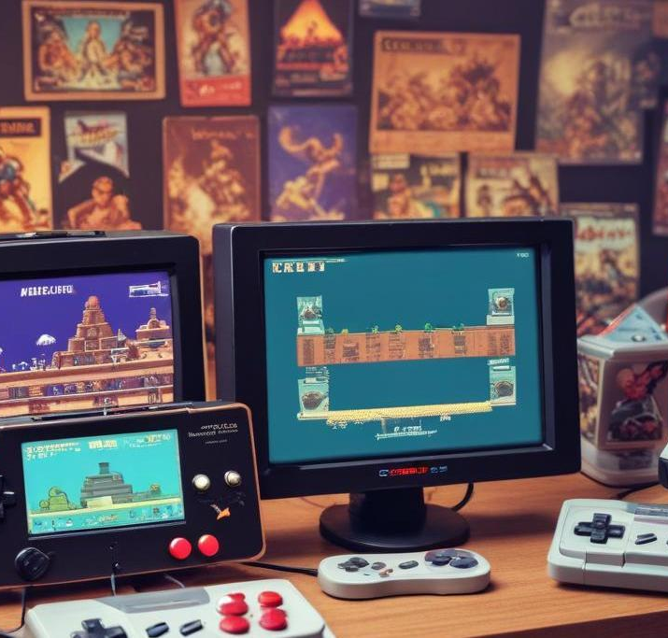
Introduction
AI Snake Game implemented using Deep Q-Learning.
Uses Reinforcement Learning to train an AI agent to play the Snake game.

Slide 3
Problem Statement
Traditional Snake game is controlled by humans.
Aim: Develop an AI agent that learns how to play efficiently using Deep Q-Learning.

Slide 4

Technology Stack
Programming Language: Python
Libraries Used:
TensorFlow / PyTorch (Neural Network Training)
OpenAI Gym (Environment)
NumPy & Matplotlib (Data Processing & Visualization)
Game Engine: Pygame

Slide 5
What is Reinforcement Learning and Q-learning ?
A machine learning paradigm where an agent learns by interacting with the environment.
The agent receives rewards or penalties based on its actions to maximize long-term gains.
Q-Learning is a Reinforcement Learning algorithm.
Deep Q-Network (DQN) uses a neural network to approximate Q-values.
The agent learns the best action to take at each state.

Slide 6
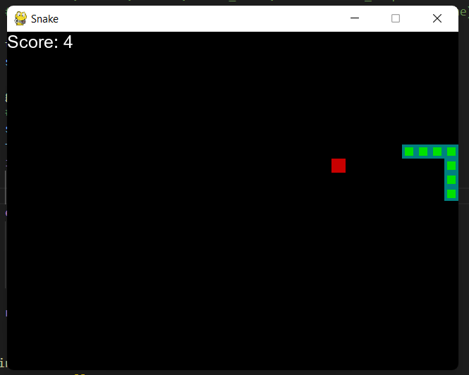
How AI Learns to Play Snake
State Representation:AI observes the game (snake position, food position, obstacles).Uses numerical values for an efficient representation of the game environment.
Action Selection:AI decides where to move (Up, Down, Left, Right) based on predicted Q-values.
Reward System:+10 for eating food-10 for hitting a wall or itselfSmall penalty for each step to encourage faster food collection.
Training with Deep Q-Learning:AI trains through multiple episodes, learning from rewards & penalties.Uses experience replay to improve learning efficiency.

Slide 7
Training Phases
AI plays thousands of games to improve.
Uses an epsilon-greedy strategy:
Initially, AI explores randomly.
Over time, AI exploits learned knowledge to make better moves.

Slide 8
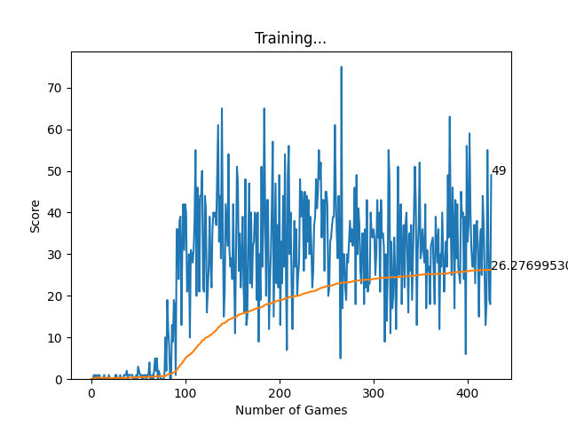
Training Graphs
Graph Explanation:
Blue Line: Scores per game.
Orange Line: Moving average of scores over time.
AI starts with random moves but improves as training progresses.
Impact of Hyperparameters:
Learning Rate: Controls how quickly the AI updates knowledge.
Discount Factor: Determines importance of future rewards.
Batch Size: Affects training stability.

Slide 9
Results & Performance
AI gradually learns optimal strategies.
Performance Comparison:
Initial AI score (random moves): ~5
AI score after training: ~30+
Human average score: ~20+
AI outperforms most human players after sufficient training.

Slide 10
Possible Improvements
Enhancements:
Implement Double DQN for better learning.
Use Convolutional Neural Networks (CNN) for better state representation.
Optimize reward system for faster training.
Real-World Applications:
CNN-based RL is used in self-driving cars, robotics, and automated trading.

Slide 11

Conclusions
Successfully implemented AI that learns to play Snake.
Reinforcement Learning shows great potential for game AI.
Future scope: Apply similar techniques to other complex games.

Slide 12
Thank You
Any Question ?

